Slide 1
Group 10 HW2 for Digital Economy & Decision Analytics
Shaoyuan Xia
Jiayi Cong
Danni Luo
Team NO.10

Slide 2
Outline of July 9 HW
code the pdf plot from slide 20, DEDA class, unit_5
create a N( μ, Σ ), try in a rotating plot
repair the slider plot for BTC
find a RF example

Slide 3
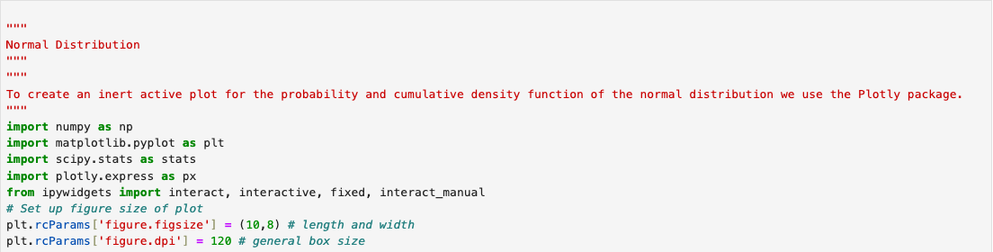
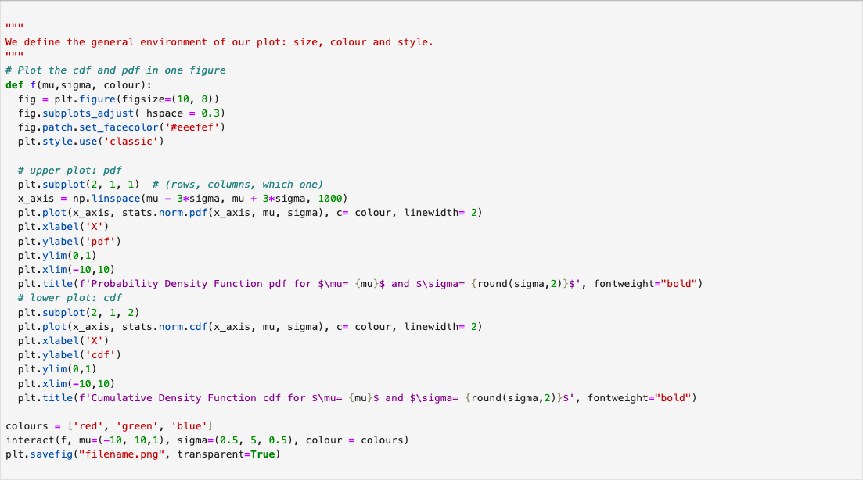
1. Normal Distribution

Slide 4
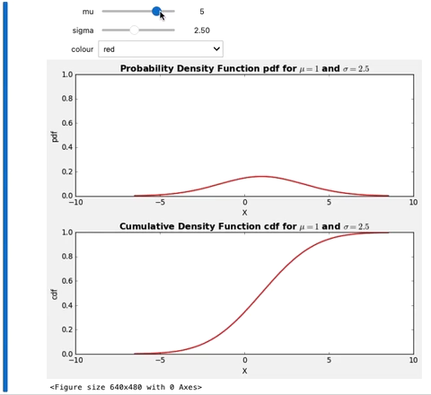
Normal Distribution & PDF plot

Slide 5
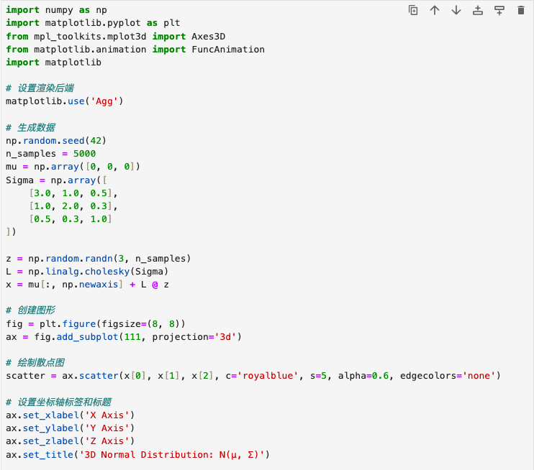
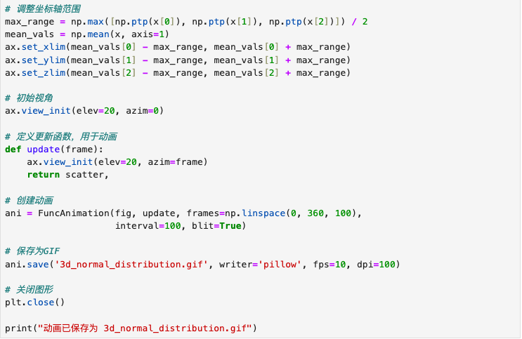
2. Code for creating a N( μ, Σ ) and its rotating plot
method 1: generate a rotating animation GIF

Slide 6
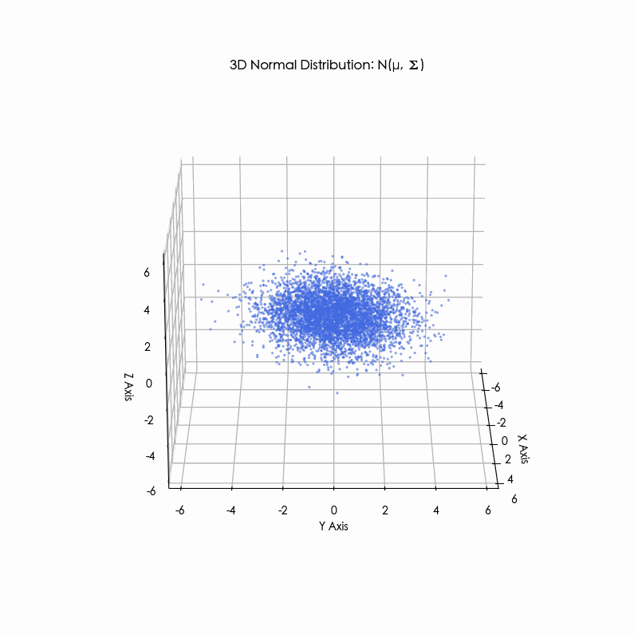
A rotating plot for N( μ, Σ )

Slide 7
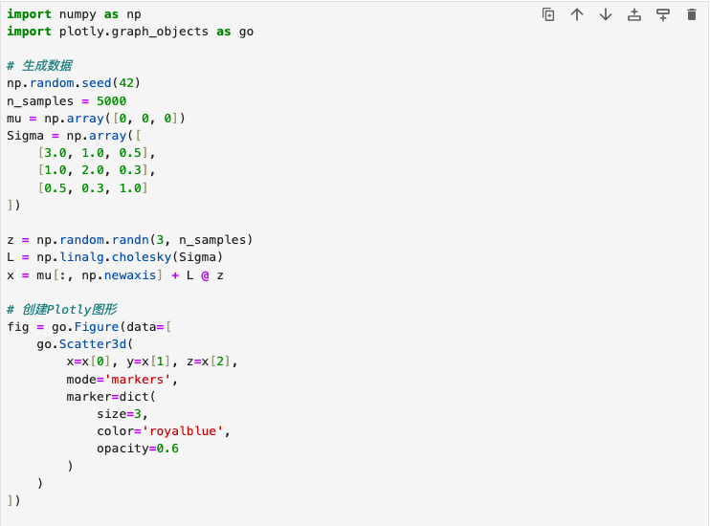
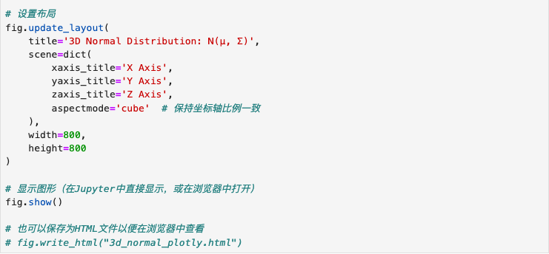
2. Code for creating a N( μ, Σ ) and its rotating plot
method 2: implementing interactive 3D graphs using Plotly

Slide 8
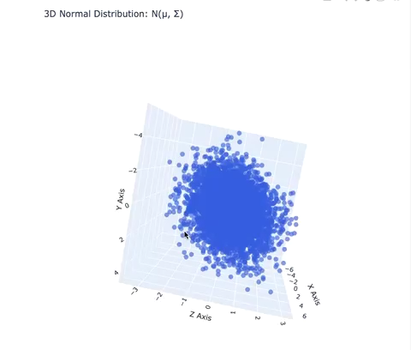
A rotating plot for N( μ, Σ )

Slide 9
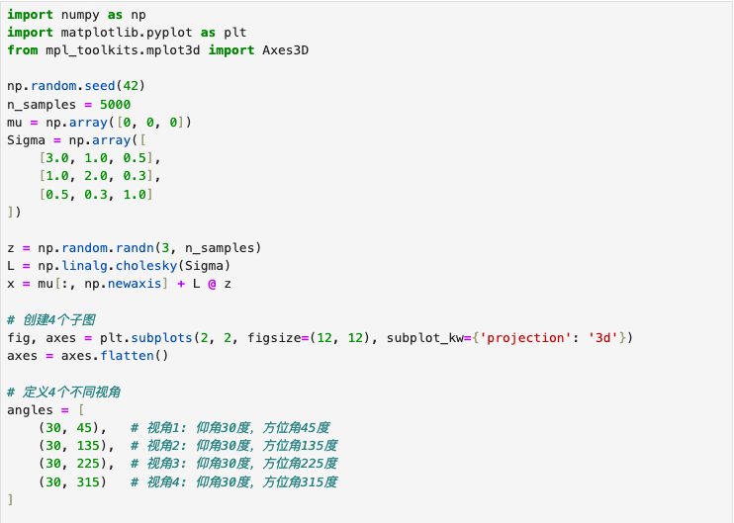
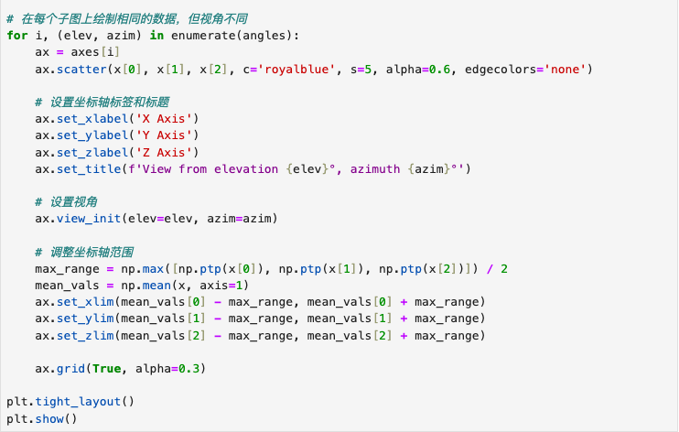
2. Code for creating a N( μ, Σ ) and its rotating plot
method 3: generate static multi-angle views

Slide 10
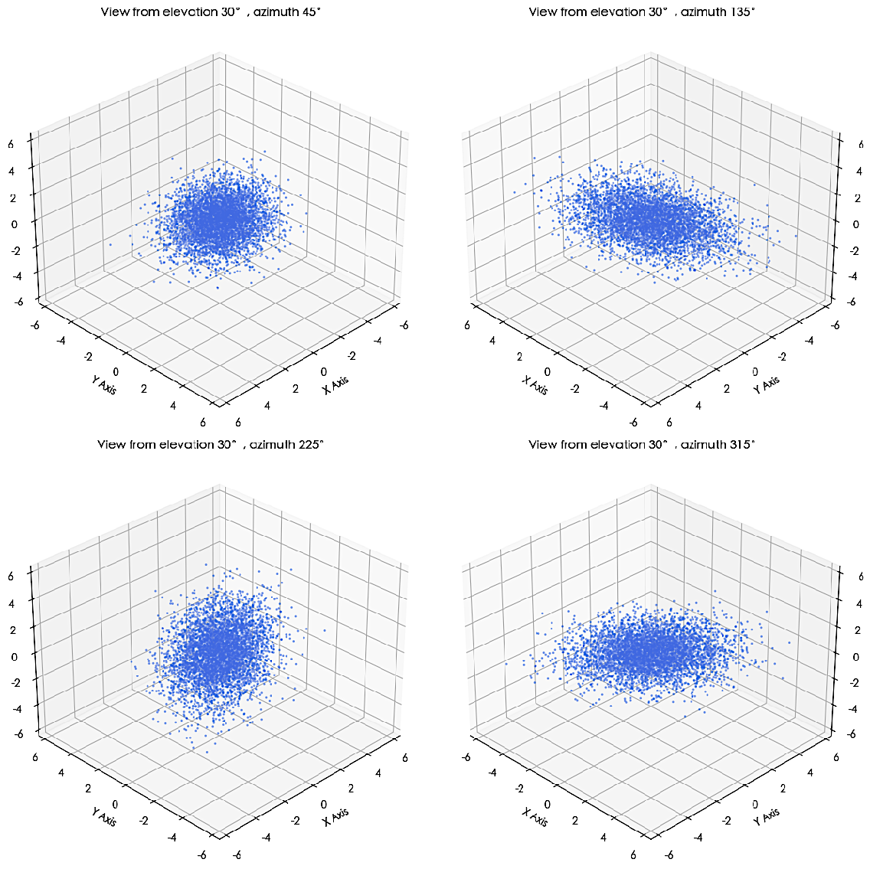
A rotating plot for N( μ, Σ )

Slide 11
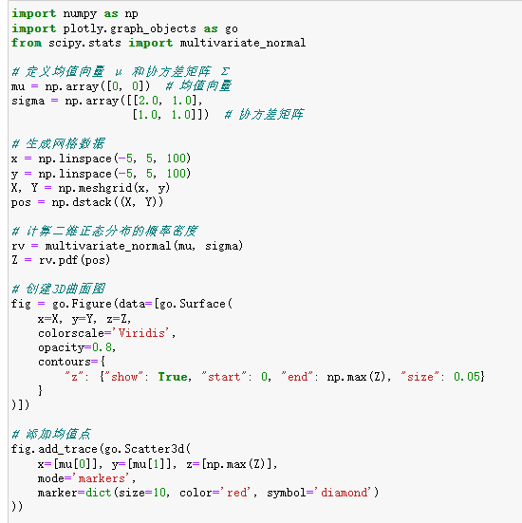
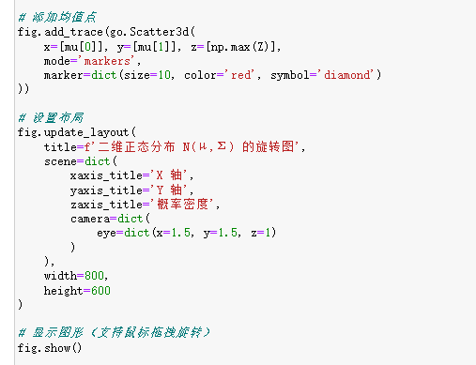
Code for creating a N( μ, Σ ) and its PDF rotating plot

Slide 12
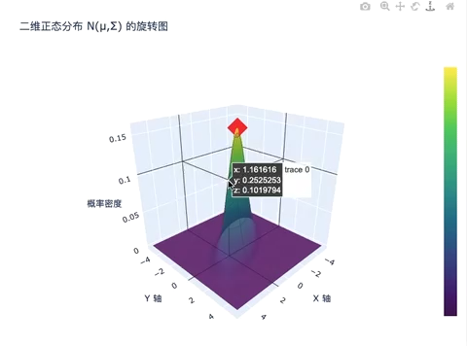
A Possibility Density Function plot for N( μ, Σ )

Slide 13
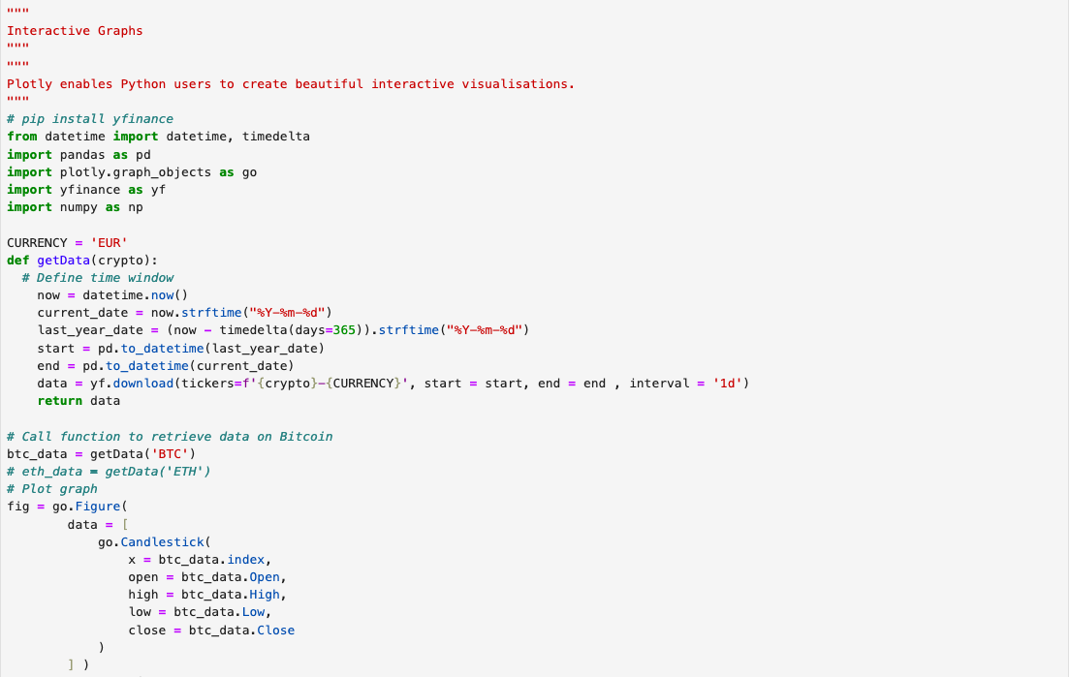
3. Time Series with Range slider for BTC

Slide 14
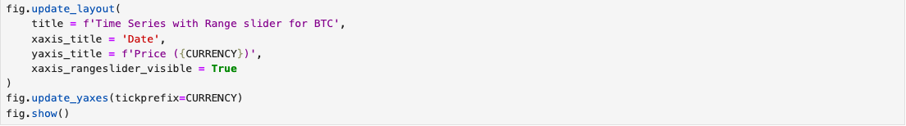
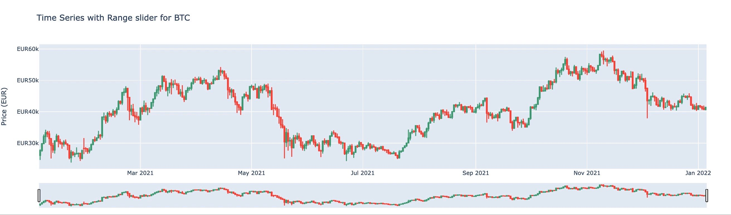
3. Time Series with Range slider for BTC

Slide 15
4. A Random Forest example
Business Problem: Customer Churn Prediction
A telecommunications company wants to predict which customers are likely to stop using their services (churn) so they can proactively implement retention strategies. The company has collected the following customer data:
Tenure (months of service)
Monthly call minutes
Monthly SMS count
Data usage (GB)
Number of customer service complaints
Contract type (month-to-month, annual, biennial)
Payment method
Service plan type
The goal is to predict whether a customer will churn in the next quarter based on these features (binary classification problem).

Slide 16
Business Problem: Customer Churn Prediction
Why Random Forest?
Random Forest is well-suited for this problem because:
Handles mixed data types (numeric and categorical)
Captures non-linear relationships
Considers feature interactions
Works with high-dimensional data
Robust to noise and overfitting
Business Value
With this model, the telecom company can:
Identify high-risk churn customers for early intervention
Understand which factors most influence customer churn
Optimize service strategies to improve retention
Reduce marketing costs by targeting retention efforts effectively
Random Forest performs well here because it automatically handles complex feature interactions and provides interpretable feature importance rankings.

Slide 17
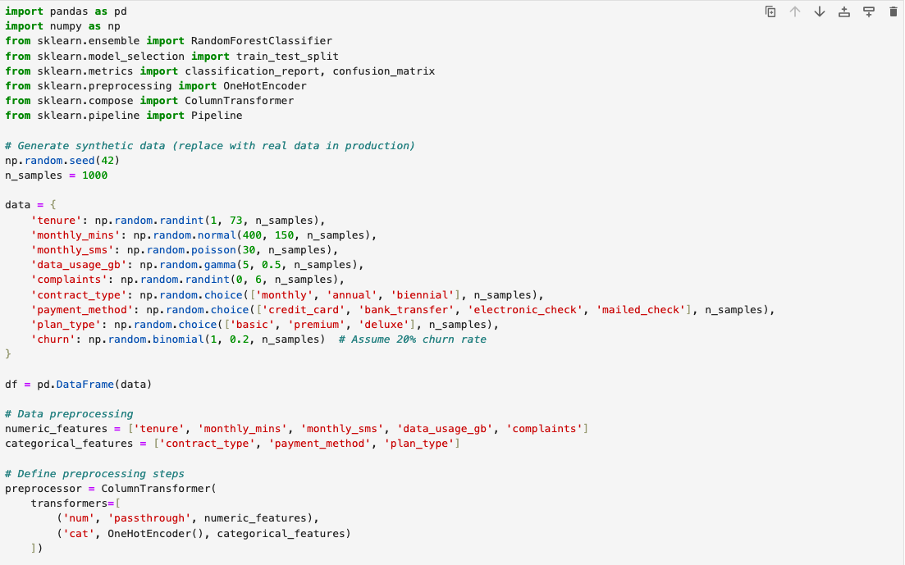
Code for Customer Churn Prediction

Slide 18
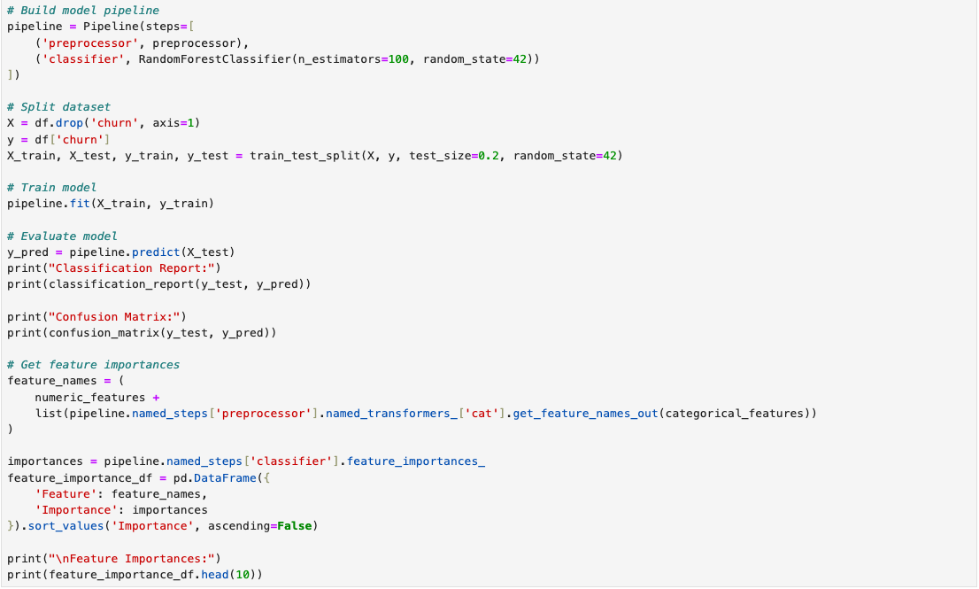
Code for Customer Churn Prediction

Slide 19
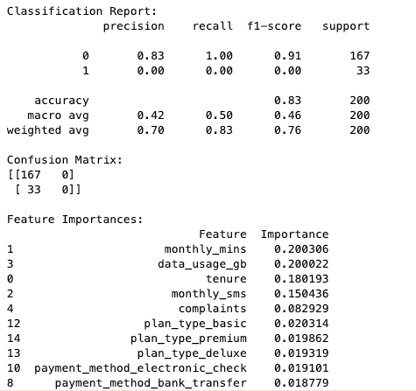
Result & analysis for Customer Churn Prediction
The model evaluation results indicate a critical issue with class imbalance, where the model excels at predicting non-churn customers (class `0`) but fails entirely to identify churners (class `1`). With 83% overall accuracy, the confusion matrix reveals 167 true negatives (correct non-churn predictions) and 33 false negatives (all churn cases misclassified), underscoring the model’s inability to detect churn. The classification report shows perfect recall (100%) for non-churn but zero precision, recall, and F1-score for churn, confirming the bias toward the majority class. Feature importance highlights `monthly_mins`, `data_usage_gb`, and `tenure` as key predictors, suggesting customers with low usage or short tenure are more likely to churn.
To improve, address class imbalance through techniques like SMOTE, tune model hyperparameters, and engineer additional features. For business action, prioritize retention efforts on high-risk segments identified by influential features.

Slide 20
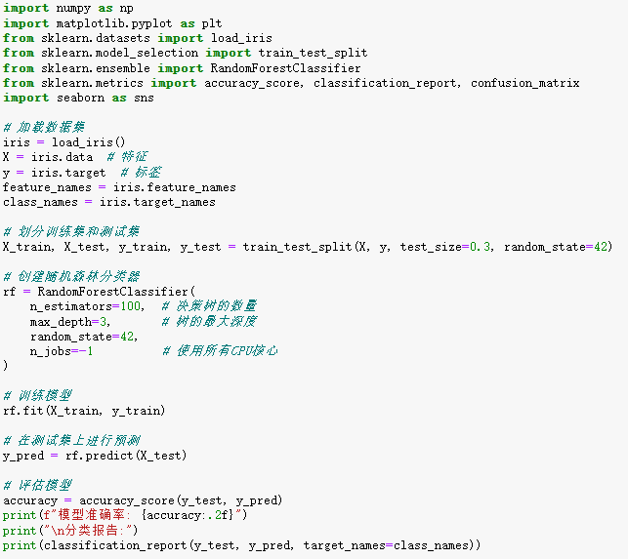
Another example of RF

Slide 21
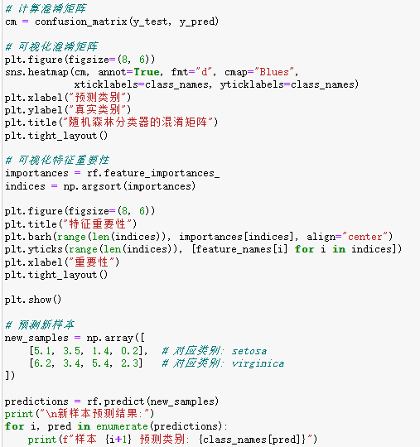
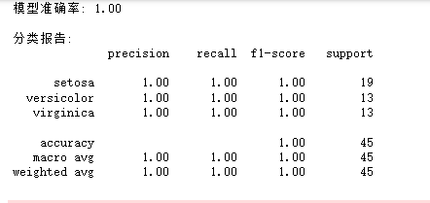
Another example of RF

